Slide 1
Data Privacy and Legal and Ethical Aspects of Data Management
Week 12
Dr. Farshid Keivanian

Slide 2
Week 12: Outline
Key Concepts – Data Transparency, Ethics, and Privacy
Story 1: The Consent Confusion at MedData Research
Story 2: The Algorithm Audit at EduTrack Analytics
Part B – Independent Work on Assessment 3
Week 12 – Milestone Unlocked: From Raw Data to Reliable Insights
Have You Completed the Survey
Stay Connected

Slide 3
Key Concepts – Data Transparency, Ethics, and Privacy
1. Data Transparency & Accountability
Organisations must be open about how they collect, use, and share data.
Clear records and audit trails build trust and responsibility.
2. Ethical Data Practices
Follow fairness, honesty, and respect when handling people’s data.
Make decisions that are ethical, not just legal.

Slide 4
Key Concepts – Data Transparency, Ethics, and Privacy
3. Privacy Laws & Protection
Australian Privacy Act (APPs): Sets rules for how businesses handle personal info.
EU GDPR: European law that gives individuals strong rights over their data.

Slide 5
Key Concepts – Data Transparency, Ethics, and Privacy
4. Key Terms to Know
Personal information: Data that identifies a person (name, email, address).
Sensitive information: Private details like health, beliefs, or ethnicity.
Privacy policy: Explains how an organisation manages and protects data.
Data ethics: Doing the right thing with data — not just what’s allowed.

Slide 6
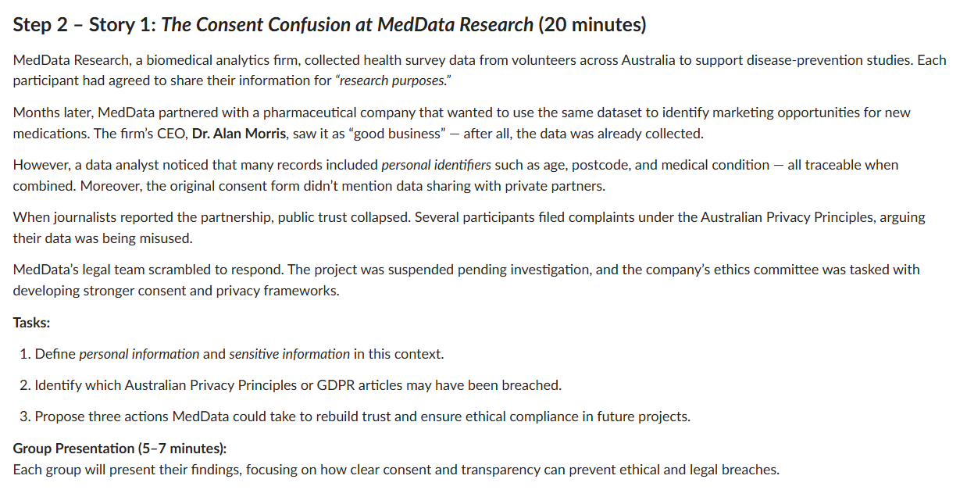

Story 1: The Consent Confusion at MedData Research
Explain key terms — define personal information and sensitive information in this case.
Find privacy breaches — identify which APPs or GDPR rules may have been broken.
Suggest solutions — propose three actions MedData can take to rebuild trust and ensure ethical data use.
Then, present their findings in a 5–7 minute group discussion, showing how clear consent and transparency prevent data misuse.

Slide 7
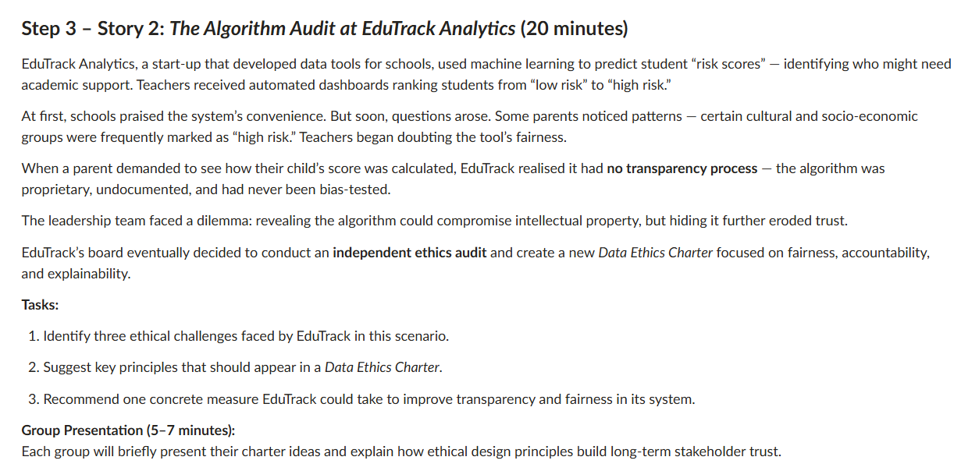
Story 2: The Algorithm Audit at EduTrack Analytics
Find issues – Identify three ethical challenges EduTrack faced (e.g., bias, lack of transparency, or fairness).
Suggest principles – List key ideas for a Data Ethics Charter (like fairness, accountability, and explainability).
Recommend one action – Propose a practical step EduTrack can take to make its system more transparent and fair.
Then, in a 5–7 minute group talk, explain how these ideas help build long-term trust with schools, parents, and students.

Slide 8
Part B – Independent Work on Assessment 3
Assessment 3 – Part B Presentation Guide (20 Marks)
What You Need To Do
You must create:
- A PowerPoint presentation
- Record yourself speaking over the slides
- Export it as an MP4 video
- Submit the MP4 file

Slide 9
Part B – Independent Work on Assessment 3
Your presentation must be:
- About 4–5 minutes
- Clear and professional
- Based on the SmartHealth Clinic case study
- Include answers to all 7 questions
- Use 1–2 slides per question

Slide 10
Part B – Independent Work on Assessment 3
Step 1 — Understand the Main Problem in the Case Study
The clinic had many serious database problems:
Main Issues
- Duplicate patient records
- Wrong or missing medical data
- Telehealth and clinic systems not syncing properly
- Shared staff logins

Slide 11
Part B – Independent Work on Assessment 3
- No access control
- Failed backups
- Weak security
- Privacy law violations
- Ethical problems with sharing patient data

Slide 12
Part B – Independent Work on Assessment 3
Your job is to explain:
What went wrong
Why it is dangerous
How you would fix it

Slide 13
Part B – Independent Work on Assessment 3
Step 2 — Create Your Slide Structure
You can use something like this:
Slide | Topic
1 | Title Slide
2 | Introduction to SmartHealth problems
3–4 | Q1 Database Design
5–6 | Q2 Data Integrity
7–8 | Q3 Azure SQL & Architecture
9–10 | Q4 Database Security
11–12 | Q5 Privacy Laws (APPs)
13–14 | Q6 Ethical Considerations
15–16 | Q7 Practical Improvement Plan
17 | Conclusion
18 | References
You do NOT need too much text.

Slide 14
Part B – Independent Work on Assessment 3
Question-by-Question Guide) Q1 — Database Design
Explain how you would redesign the database to stop duplicate and inconsistent data.
Include These Terms
Entities
Primary Keys
Relationships
Normalisation

Slide 15
Part B – Independent Work on Assessment 3
Explanation
You should explain:
Each patient should only have ONE patient ID
Tables should be connected properly
Data should not be repeated in multiple places

Slide 16
Part B – Independent Work on Assessment 3
Example Tables
Patient Table – Fields: PatientID (PK), Name, DOB, MedicareNo
Appointment Table – Fields: AppointmentID (PK), PatientID (FK), DoctorID, Date
Doctor Table – Fields: DoctorID (PK), Name, Specialty

Slide 17
Part B – Independent Work on Assessment 3
Important Ideas
Primary Key (PK)
Unique ID for each record.
Foreign Key (FK)
Links tables together.
Normalisation
Organising data to reduce duplication.

Slide 18
Part B – Independent Work on Assessment 3
Helpful Hint
Mention:
The database should be normalised to at least Third Normal Form (3NF).
This sounds professional and helps marks.

Slide 19
Part B – Independent Work on Assessment 3
Q2 — Data Integrity & Constraints
Explain rules that stop bad data entering the database.
Include These
Constraints
Validation rules
Duplicate prevention

Slide 20
Part B – Independent Work on Assessment 3
Good Examples
UNIQUE Constraint
Stops duplicate Medicare numbers.
NOT NULL
Important fields cannot be empty.
CHECK Constraint
Example:
Age cannot be negative
Appointment date cannot be in the past

Slide 21
Part B – Independent Work on Assessment 3
Referential Integrity
Prevents orphan records.
Example Sentence
A UNIQUE constraint on MedicareNumber would prevent duplicate patient records.

Slide 22
Part B – Independent Work on Assessment 3
Q3 — Azure SQL & System Architecture
Explain how Azure SQL can improve system consistency.
Main Problem in Case
Telehealth updated instantly but clinic records updated weekly.

Slide 23
Part B – Independent Work on Assessment 3
Your Solution
Explain:
Use one central Azure SQL database
Real-time synchronisation
Cloud backups
High availability

Slide 24
Part B – Independent Work on Assessment 3
Important Terms
Azure SQL Database
Real-time syncing
Centralised database
Disaster recovery
Automated backups
Simple Example
Both telehealth and clinic systems should connect to the same Azure SQL Database in real time.

Slide 25
Part B – Independent Work on Assessment 3
Q4 — Database Security Design
Explain how to protect patient data.
Mention These Security Measures
Role-Based Access Control (RBAC)
Receptionists should NOT have surgeon-level access.
Multi-Factor Authentication (MFA)
Extra login security.

Slide 26
Part B – Independent Work on Assessment 3
Encryption
Protect data:
At rest
In transit
Audit Logs
Track who changes records.
Strong Password Policies
Separate User Accounts
No shared logins.

Slide 27
Part B – Independent Work on Assessment 3
Very Important
Mention:
Healthcare data is highly sensitive and requires strict access control.

Slide 28
Part B – Independent Work on Assessment 3
Q5 — Privacy & Australian Law (APPs)
Explain how SmartHealth violated privacy laws.
Focus on APPs (Australian Privacy Principles)
Good APP Examples
APP 6 — Use and Disclosure
They tried sharing patient data without consent.
APP 11 — Security of Personal Information
Weak security failed to protect patient data.

Slide 29
Part B – Independent Work on Assessment 3
APP 1 — Open and Transparent Management
No clear privacy policies.
What They Should Have Done
Get patient consent
Protect personal data
Create privacy policies
Train staff

Slide 30
Part B – Independent Work on Assessment 3
Helpful Hint
You do NOT need to explain all APPs. Focus on 2–4 important ones clearly.

Slide 31
Part B – Independent Work on Assessment 3
Q6 — Ethical Considerations
Explain ethical risks.
Main Ethical Problems
Patient Harm
Wrong data may cause wrong treatment.
Loss of Trust
Patients expect privacy.

Slide 32
Part B – Independent Work on Assessment 3
Data Sharing Without Consent
Unethical use of sensitive data.
Poor Governance
No staff training or accountability.
What To Suggest
Ethical data handling
Staff training
Transparency
Patient consent

Slide 33
Part B – Independent Work on Assessment 3
Strong Sentence Example
Patient safety must always be more important than business profit.

Slide 34
Part B – Independent Work on Assessment 3
Q7 — Practical Improvement Plan
If YOU were the DBA, what 3 things would you fix first?
Easy Structure
1. Fix Security
Remove shared logins
Add RBAC
Enable MFA

Slide 35
Part B – Independent Work on Assessment 3
2. Improve Data Integrity
Add constraints
Remove duplicate records
Real-time syncing
3. Backup & Recovery
Automated backups
Recovery testing
Disaster recovery plan

Slide 36
Part B – Independent Work on Assessment 3
Helpful Hint
Use priority order:
Immediate
Short-term
Long-term
This looks professional.

Slide 37
Part B – Independent Work on Assessment 3
Step 3 — Add References
Requirement
Use at least:
5 academic sources
You Can Use
Journal articles
Textbooks
Microsoft Azure documentation
Australian Privacy Principles website

Slide 38
Part B – Independent Work on Assessment 3
Avoid
Wikipedia
Random blogs
Unreliable websites

Slide 39
Part B – Independent Work on Assessment 3
Step 4 — Design Good Slides
What To Do
Use:
Icons
Diagrams
Tables
Flowcharts
Short bullet points

Slide 40
Part B – Independent Work on Assessment 3
- Keep slides clean
- Use large readable font
- Use professional colours

Slide 41
Part B – Independent Work on Assessment 3
What NOT To Do
- Do not copy large paragraphs
- Do not overcrowd slides
- Do not read directly from slides
- Do not use tiny text
- Do not exceed 5 minutes
- Do not forget references
- Do not submit PPT instead of MP4

Slide 42
Part B – Independent Work on Assessment 3
Step 5 — Record Your Presentation
In PowerPoint
Go to:
Slide Show
→ Record Slide Show → Record from Beginning
Speak clearly and confidently.

Slide 43
Part B – Independent Work on Assessment 3
Presentation Tips
Good Presentation
- Clear voice
- Explain ideas simply
- Maintain steady pace
- Sound confident
- Stay within 4–5 minutes

Slide 44
Part B – Independent Work on Assessment 3
Step 6 — Export as MP4
Go to:
File
→ Export → Create a Video
Use:
Standard (480p)
Check: “Use Recorded Timings and Narrations”

Slide 45
Part B – Independent Work on Assessment 3
Step 7 — Submit Correct Files
Submit:
Part A
OzCo database file
Part B
MP4 presentation

Slide 46
Part B – Independent Work on Assessment 3
What Helps You Get High Marks
You should:
- Explain business impact clearly
- Use correct database terms
- Give practical solutions
- Link problems to APP laws
- Explain ethical risks properly
- Use professional visuals
- Include strong references
- Keep slides concise
- Speak confidently

Slide 47
Part B – Independent Work on Assessment 3
Simple Overall Strategy
Best Way To Structure Answers
For each question:
1. Identify the problem
“What went wrong?”
2. Explain the risk
“Why is it dangerous?”
3. Give the solution
“How would you fix it?”
This structure works very well for this assessment.

Slide 48
Week 12 – Milestone Unlocked: From Raw Data to Reliable Insights
Our students have completed an exciting journey through Database Design, Data Quality, and Database Security — transforming data into meaningful business solutions!

Slide 49
Week 12 – Milestone Unlocked: From Raw Data to Reliable Insights
From designing ERD models and enforcing referential integrity in Microsoft Access, to creating relational databases, writing SQL queries, exploring Azure database concepts, and improving data security practices, they have developed valuable real-world skills in:

Slide 50
Week 12 – Milestone Unlocked: From Raw Data to Reliable Insights
#DataModeling #SQLQueries #DatabaseSecurity #DatabaseDesign #ProblemSolving #MicrosoftAccess #Azure

Slide 51
Week 12 – Milestone Unlocked: From Raw Data to Reliable Insights
Through hands-on projects such as the OzCo database case study, database validation activities, backup planning, and data management tasks, our students have strengthened their confidence and practical database skills for future industry roles.

Slide 52
Week 12 – Milestone Unlocked: From Raw Data to Reliable Insights
Let’s celebrate their achievements with a #SelfieCelebration!
#StudentSuccess #ProudMoment #DataAnalytics #DataManagement #DatabaseDesign #BusinessIntelligence #MicrosoftAccess #MicrosoftAzure #OzCoProject #LearningByDoing #Education #ACU #DataDrivenFuture

Slide 53
Have You Completed the Survey?
Your feedback is important in improving the learning experience for future students. Please reflect on the following in your survey responses:
How quickly your questions were answered through Canvas or email
How effective the lecture slides and PowerPoint designs were in supporting your learning

Slide 54
Have You Completed the Survey?
The clarity of assessments and learning materials
Overall teaching quality and student support
Thank you for taking the time to complete the survey.

Slide 55

Thank You
Happy Learning and Bright Futures Ahead! Dr. Farshid Keivanian Stay Connected: linkedin.com/in/farshid-keivanian github.com/FarshidKeivanian
Education is the most powerful weapon you can use to change the world. — Nelson Mandela

